Slide 1
SVKM’s NMIMS
Mukesh Patel School of Technology Management and Engineering
B.Tech Integrated Program
---
Brief Updates from Chairman - Corporate Relations & Placements

Slide 2
About Corporate Relations
Inplant Training and Placement Team
Headed by Prof. Nikhil Gala, Chairman Corporate Relations & Placements
Dedicated Team of Placement Executives
Senior & Junior Students Placement Coordinators
Major functions
Industry Connect - MoU’s
Inplant training
Placements
Expert talks, Industry Competitions

Slide 3
About Training & Placement Cell
The placement cell acts as a facilitator for Technology Programs like B.Tech, MCA & B.Tech Integrated.
Department focuses on building skills that makes the student industry ready
Regular interactive sessions by the Department officials, Industry experts, Alumni on regular basis
Training and Testing Modules for Aptitude, Technical and Life skills
CV Review
Regular SWOT Analysis
Mock Interviews
Regular Counseling/ Career Guidance sessions
Feedback shared with parents on regular basis
Handholding of each student until he/she achieves the dream offer
Strong industry connect ensured all the selected students of B.Tech obtain joining related information despite COVID -19 situation

Slide 4
Placement achieved through strong Industry connect (2019-20)
130+ companies considered B.Tech students for Final Placements
Multiple Job offers for many B.Tech students
International Offers
8 International companies with packages up to 65 Lakhs* INR
Domestic Offers
Highest Package : 12.4 Lakhs per annum
Average Package: 5.25 Lakhs per annum
46 Companies on Campus offering more than 6 Lakhs per annum.
174 B.Tech students placed with Dream offers
MCA
47+ companies considered MCA students for both Internship and Final Placements
Highest Package : 8.70 Lakhs per annum
Average Package: 4 Lakhs per annum
* As per conversion of INR to Japanese Yen

Slide 5
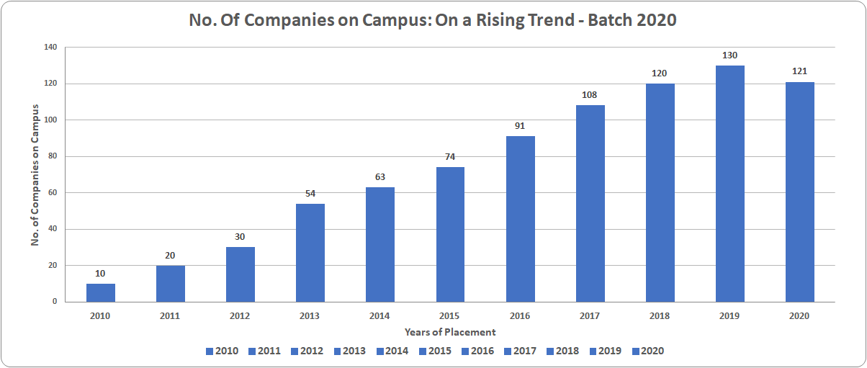
Placements Statistics
Season On

Slide 6
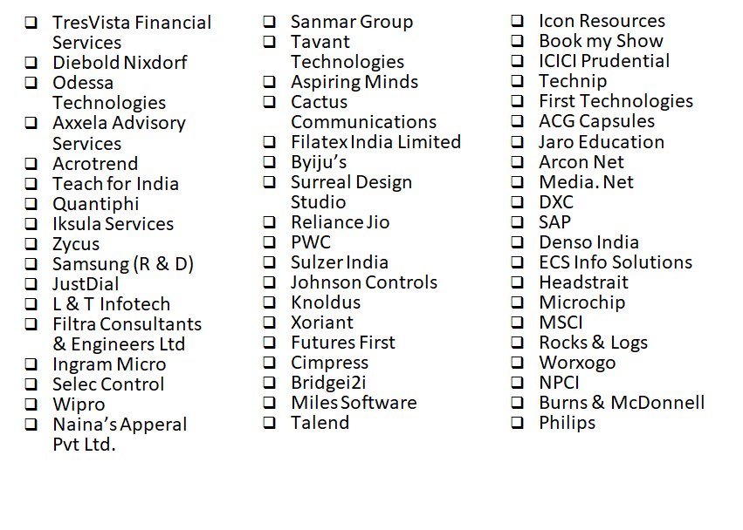






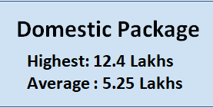












Slide 7



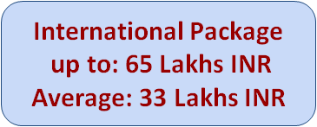





Japan:
Works Applications
NTT Communications
Rakuten
Mercari
A & B Ltd
Bizreach
Uniqlo Co Ltd
Belgium:
Daikin

Slide 8
Highlights of Inplant Training

Slide 9
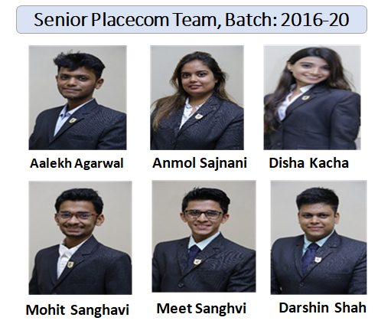
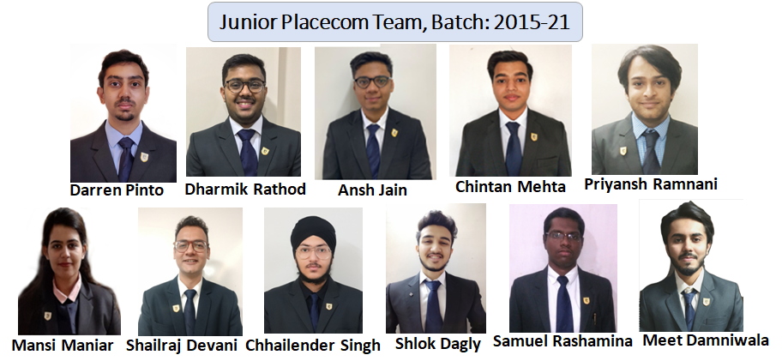
Our Team
Chairman Corporate Relations- Prof. Nikhil Gala
Placement Executives
Student Placecom Team - Selected via a rigorous interview process
Provided training to work with corporate recruitment teams leading to honing of their people skills

Slide 10
Industry exposure through Inplant Training
Effective hands on and real time exposure of industry processes to engineering students
Transformation of theoretical knowledge into practical solutions to real life challenges
Builds behaviour aspects that develops a students leadership qualities
Develops professional aptitude along with hands on skills and implementation knowledge of latest tools and technology required in industry

Slide 11
Preparation for Entry into the Corporate Sector
Aptitude Training
Quantitative Reasoning , Data Interpretation , Verbal Reasoning, Reading, Comprehension , Analytical Reasoning
Technical Training
Programming Fundamentals; OOP’s with Python or Java; Advanced Database Concepts; Python Database Integration
Stream specific advanced training and refresher courses on skills required by companies
Employability Training
Effective Resume Building, Understanding Corporate Environment and Etiquettes, Interview Skills, Group Discussions, Presentation Skills

Slide 12
Inplant Training Process
01
Grooming and Employability Training
Pre Hiring Preparation
02
Hiring Process
Aptitude Test, Group Discussion, Technical and HR Interviews
03
As per rules and regulations of Industry
Inplant Training
04
Joint Progress Tracked by Industry Mentor and Faculty Mentor
Inplant Training Monitoring Process

Slide 13
Job Profiles- B Tech Integrated Inplant Trainees
Mechanical Engineering Design Engineer, Manufacturing Product Development Engineer, Industrial Engineer, Maintenance Trainee | Electronics and Telecommunication Engineering Technical Trainee, Product Development Engineer, Embedded Engineer
Computer Engineering Software Developer, Machine Learning Engineer, Networking Engineer | Civil Engineering Site Engineer, Contracts Administration

Slide 14



















Highest Stipend
International : 65K, Domestic: 60 K
Our Esteemed Recruiters
International Recruiters
Domestic Recruiters

Slide 15
Inplant Training Feedback by
Corporates

Slide 16



We found the Faculty Head, Corporate Relations & Placement teams to be very supportive. The students were bright and quite interested in exploring the technologies that we were managing. I am happy to state that we have picked five bright students after a rigorous evaluation.
This was the first time we hired interns from MPSTME. We had two interns for 2 semesters, they were quick to learn, proactive and dedicated to get the job done. I would definitely recommend hiring students from MPSTME.
All the students are good in terms of perspective and learning attitude. All performed well over the internship period. Considering they are fresher’s, they have a broad outlook. Looking forward to many more such interactions with this esteemed University.

Slide 17


Recruitment from MPSTME, NMIMS placement cell since past 2 instances was very positive. The placement team is always reachable, prompt with the responses & interviews are scheduled seamlessly. Interaction with faculty helped in better awareness of the institute's offerings & infrastructure in detail. The students from MPSTME, NMIMS are clearly recognized from the rest of the candidates as they are all well groomed & confident during the interview which according to me is an unique and positive trait of NMites
It has indeed been a pleasure interacting with the students of Mukesh Patel School of Technology (NMIMS) during their 1 year of internship. The students have displayed great learning and innovation skills. This combined with their excellent interpersonal and communication skills, wraps up to them being an impressive resource. We look forward to having more students from your institute as a part of our organisation.

Slide 18
Students Takeaways of Inplant Training

Slide 19
Darshin Shah, B.Tech Integrated, Computers
Inplant Training at Worley has recounted me with cross-cultural skills and fine knowledge of industry best practices. I cannot express enough thanks to our placement team & my faculty mentor for their continued support and encouragement during the phase of transition from academia to industry. I understand that we are the first batch graduating this summer 2020 but the overall experience has been overwhelming. Equal inputs from the industry and college have enabled a steep rise in my learning curve. I offer my sincere appreciation to the people involved in handing out this opportune platform.
Mohit Sanghavi, B.Tech Integrated, Computer Engineering
Inplant Training Program offers a unique platform for aspiring students to get a taste of what the real professional world is Inplant training has given me first hand exposure to the real world. It has allowed me to harness the skills, knowledge and to practice what i have learned theoretically in my academic years. It has widened my view in my future career development by providing real work experiences as I have got opportunity to explore my interest. It has helped me to learn soft skills such as way of communication, leadership quality, problem solving and teamwork. It helped me to boost my confidence as I have got the opportunity to lead a team of 5 resources.

Slide 20
Parth Ashar, B.Tech Integrated, Computers
My Inplant Training at L&T Infotech was a great learning experience that I thoroughly enjoyed. My tasks included applying analytical functions to real time data for solving complex business problems. Not only did this journey let me apply the knowledge gained in the classroom, but also injected a holistic approach in me towards meeting deadlines and working collectively as a team. Apart from my professional development, this opportunity allowed me to hone my skills and build on my logical and critical thinking ability.
The Inplant Training included many responsibilities necessary to run a business. Each day brought different circumstances and I had the opportunity to make decisions on my own and learn from both my successes and failures.The Inplant Training was a worthwhile experience and I feel that it has prepared me well for my professional career.I am glad to have selected the B.Tech Integrated program of NMIMS, MPSTME ; as the Inplant Training has been extremely beneficial in shaping my professional desires.
As a part of my a career goals, I wish to delve deeper in the field of Data Analytics by pursuing a graduate masters degree in Information Systems Management and Data Science.

Slide 21
Aadit Gandhi, B.Tech Integrated, Mechanical Engineering
Hi, I am Aadit Gandhi, and I completed my Bachelors in Mechanical Engineering from NMIMS. During my last Sem, I completed my Inplant Training from a 3D printing startup company. According to me, this was the most knowledgeable experience for me in the entire course of B. Tech (Integrated). The training not only shaped me intellectually, but also professionally. I received plenty of practical knowledge from the industry experts, and helped me conduct various projects under their guidance. Apart from that, I learnt the value of industry etiquette, and networking, which is an extremely important skill, which can never be taught in any college. Though i am graduating from college this year, the in plant training has ensured i enter the professional world with 1 year of experience. .
Malik Madlik, B.Tech Integrated, Mechanical Engineering
Inplant Training Program offers a unique platform for aspiring students to get a taste of what the real professional world is really like. It prepares the students for life after graduation. Interacting with industry professionals and working towards a common goal i.e. contributing towards the betterment of the organization gives the student a sense of responsibility, boosts confidence and overall provides an immense learning experience

Slide 22
Ananya Tiwari, B.Tech Integrated, EXTC
My Inplant Training at the National Informatics Centre was a great opportunity to learn practical ways to work in an industry. It was the perfect opportunity to use the theoretical knowledge gained by me during my B.Tech Integrated studies. Through this Inplant Training I know how to use the book knowledge into real life and implement it to find real-life solutions and implement them in the most efficient way possible. I learnt python and machine learning algorithms and how to work with data. The basics of data science and some advanced projects that were done here are really helpful to me in selecting a future pathway. The chance to work with the Government of India really helped me dig really deep into problems and solutions in an organization that is this big and deals with a widespread of problems. The mentors at the industry were extremely helpful and also great guides with so much knowledge. It was a privilege working in an environment like that.
Apart from that, the experience with my co inplant trainees was very friendly and enjoyable. It was a learning experience where my giveaway is not only the growth of my knowledge but also as a person, more confident in my work. Overall, it was an experience that would help us throughout our career and make us more confident as we have gained an experience which usually doesn’t come later in life till we don’t get our first jobs. The network made during this Inplant Training will always help me through my professional career. The curriculum design and pedagogy helped and developing problem solving approach & it helped immensely during the inplant training.The guidance and support received from my college during this inplant training was very helpful. This experience adds greatly to my resume and the work experience that I have gained will help to gain more inplant training and later a job in this field.
The inplant training is the reason why I have decided to continue my studies further in the field of data science. This is a greatly influential experience and takeaway is really good for me.

Slide 23
Dhruvin Pandya, B.Tech Integrated, EXTC
In the last year of my B.Tech Integrated degree we had to go for inplant training in the industry for 2 semesters during which I interned at Calamus Electric Pvt Ltd. I obtained exposure to the field of mechatronics by designing of various electronics circuits and help with the mechanical assembly of the same from electronics point of view. Calamus is a startup based around electric vehicles. This company is incubated by ThinQbate, incubation cell of the Marwah Group based in Sakinaka Mumbai.
During my in-plant training I was given an opportunity to visit China for manufacturing and production of our product. Towards the end of my academic year I was offered a full time job here. This is something that will probably happen to everyone who completes their entire inplant training in one company; therefore I would highly recommend doing this.
Using the knowledge that I have gained in the last 5 years of B.Tech Integrated program at Mukesh Patel School of Technology Management and Engineering along with personal practical projects helped me to secure good inplant training. In the end the hard work and the continuous help of all the faculties helped me become a better problem solver and helped me reach the goal I always desired.

Slide 24
Deep Shah , B.Tech Integrated, Civil
Looking back at the 6 year program, I am incredibly happy to have made this decision. The highlight of the program has been the in-plant training where the flexibility of choosing two separate companies in each semester gave me the chance to broaden my perspective. From execution to finishing, I was able to learn and get real world exposure in Civil Engineering to minimize the gap between what we learnt in class and what happens in the industry.
This program has been a welcome change to the hardcore theoretical approach that almost all other programs take, and I can confidently say this change has made me a more wholesome and a complete engineer today
Yash Savani, B.Tech Integrated, Civil
The In-plant training at the end of the course has been nothing but insightful. I am very grateful to MPSTME for coming up with such a dynamic course. This training has been a great way of transforming ourselves so that we can adapt to the workings of our respective industries. It has also been a phenomenal way to apply classroom knowledge in real life. I am truly grateful to the faculty for helping us out throughout as well.

Slide 25
Contact Details
For any queries please feel free to contact us:
Prof. Nikhil Gala
Chairman Placements & Corporate Relations
Email: btechintegrated@nmims.edu
Tel: +91 22 4933400/ 4020
Ms. Satabdi Das
Placement Executive
Email: btechintegrated@nmims.edu
Tel: +91 22 4933400/ 0576

